Slide 1


Community Library Management System
TEAM NO :- 10
B.Sai Sanatana Sarada – 2620030660
Shaik Shaheena Amreen - 2620030469

Slide 2
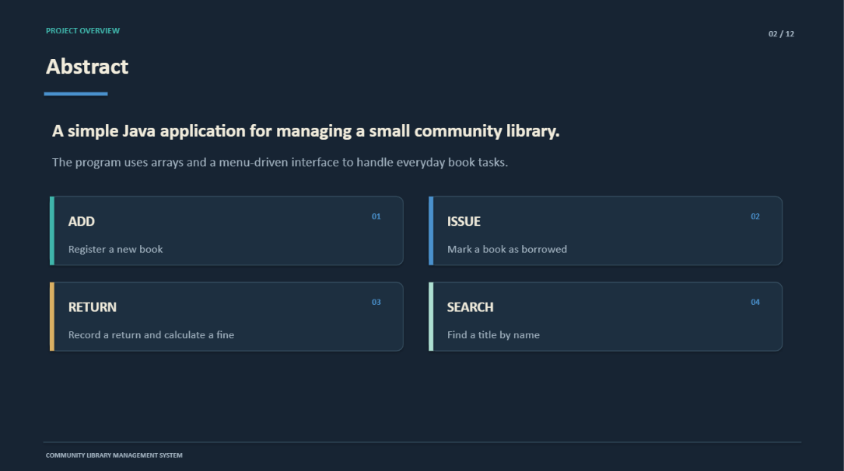

Slide 3
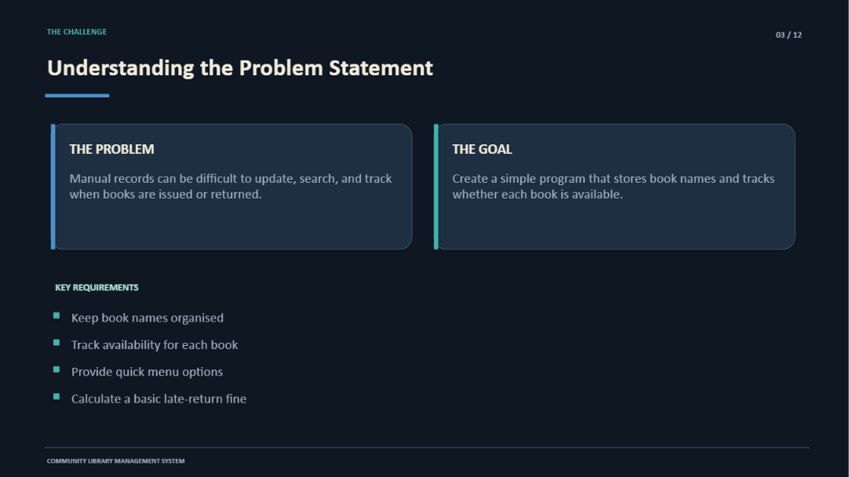

Slide 4
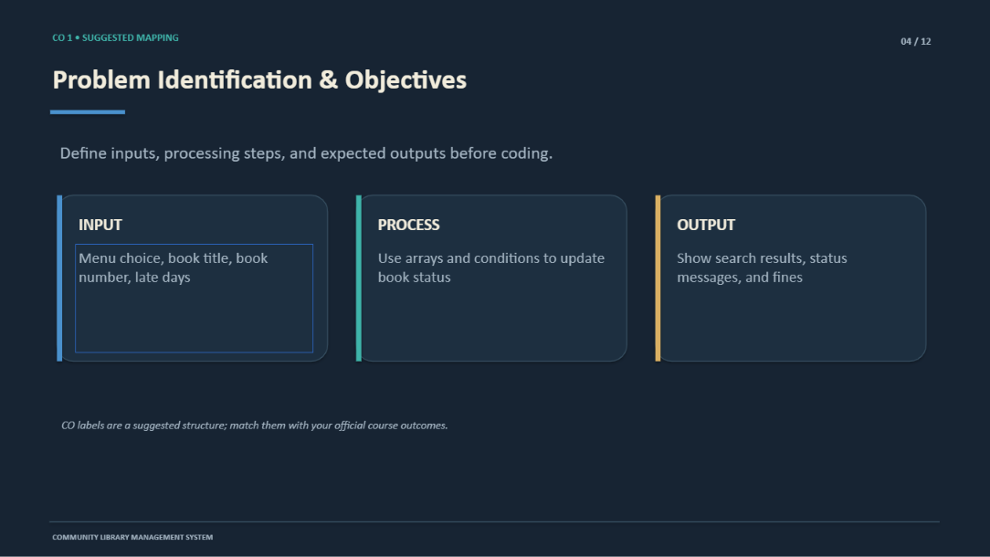

Slide 5
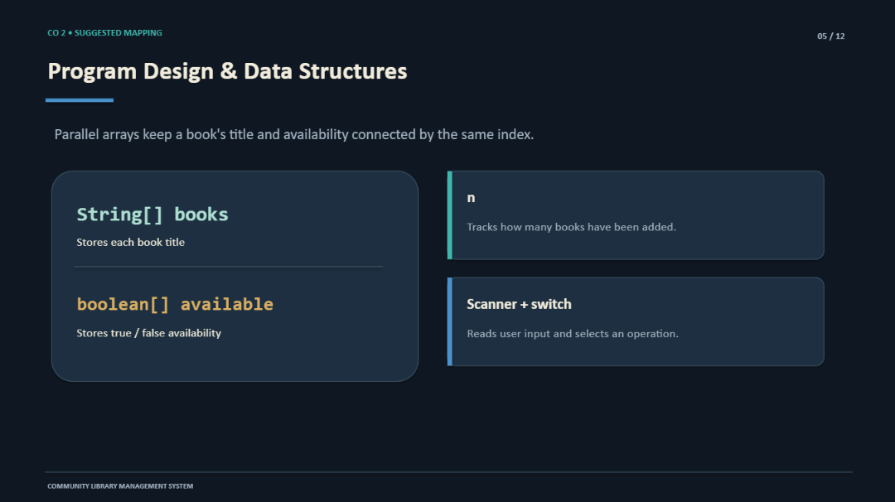

Slide 6
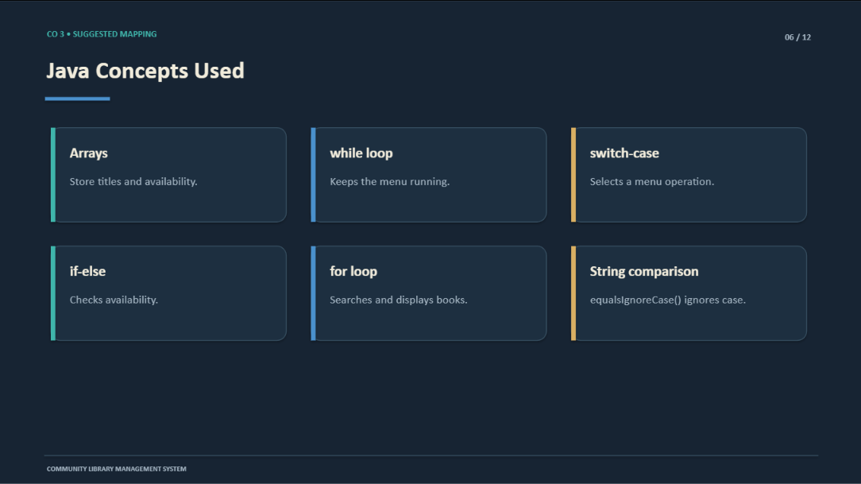

Slide 7
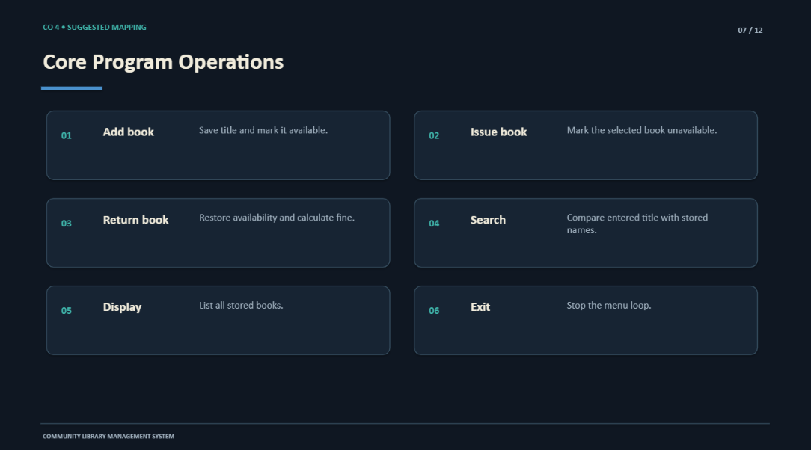

Slide 8
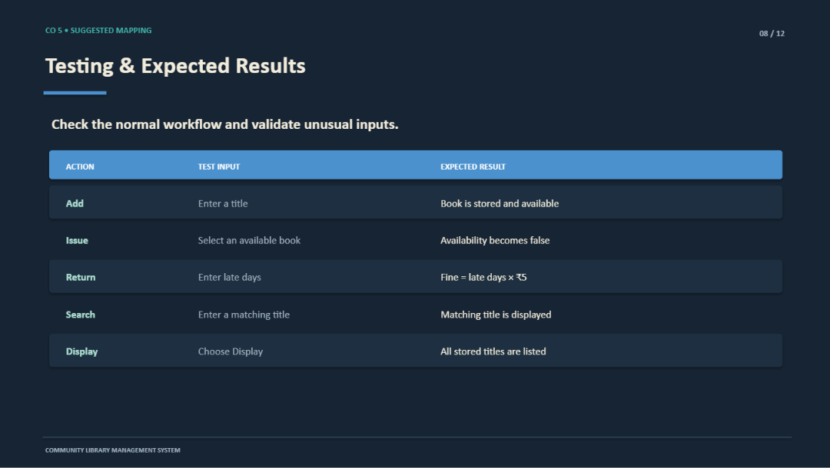

Slide 9
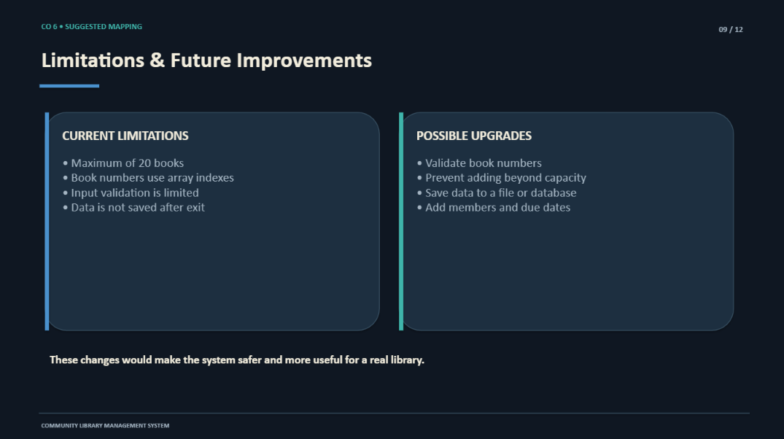

Slide 10
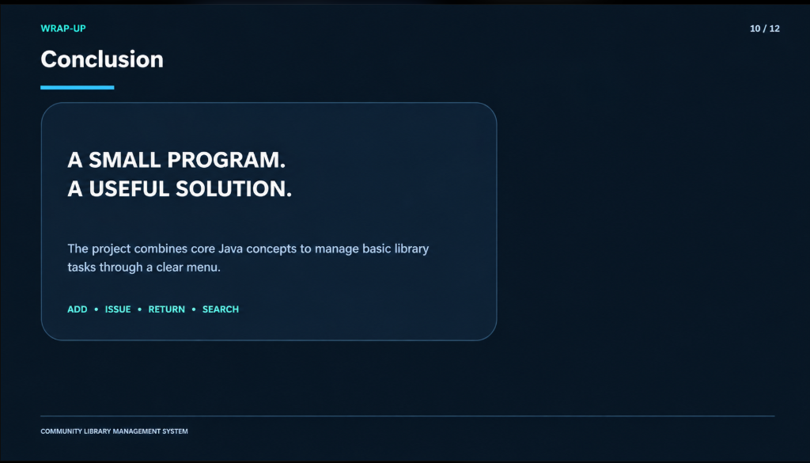

Slide 11

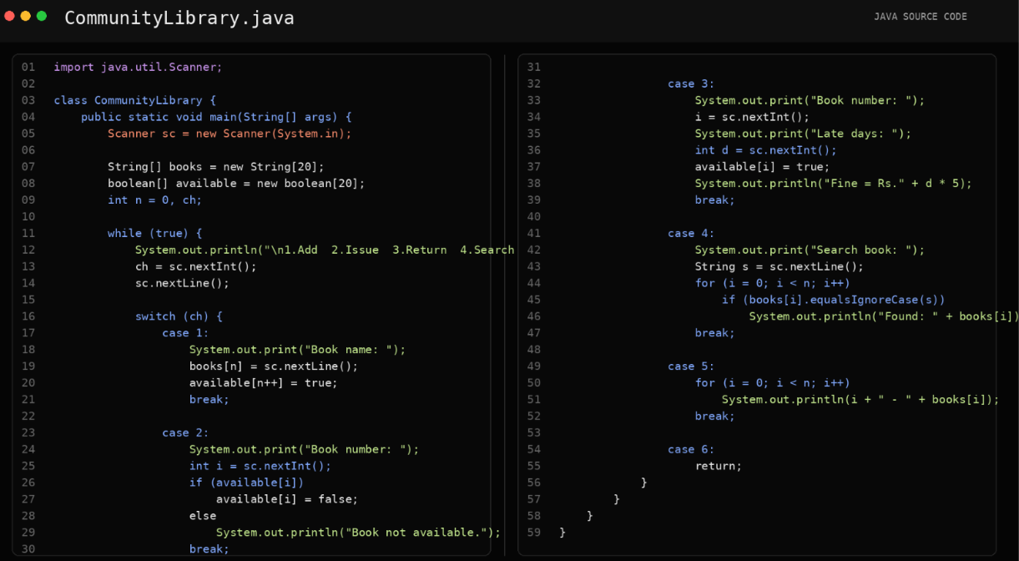

Slide 12

Github Link :-
INPUT:
Book Details
Member Details
Book ID / Member ID
Menu Choice (Add, Issue, Return, Search, Display, Exit)
OUTPUT:
Add
Issue
Return
Search
Display
Exit
https://github.com/Sarada-08/The-Community-Library-Management-System

Slide 13


